Slide 1

Class: Splash
logo which is a CLogo

Slide 2
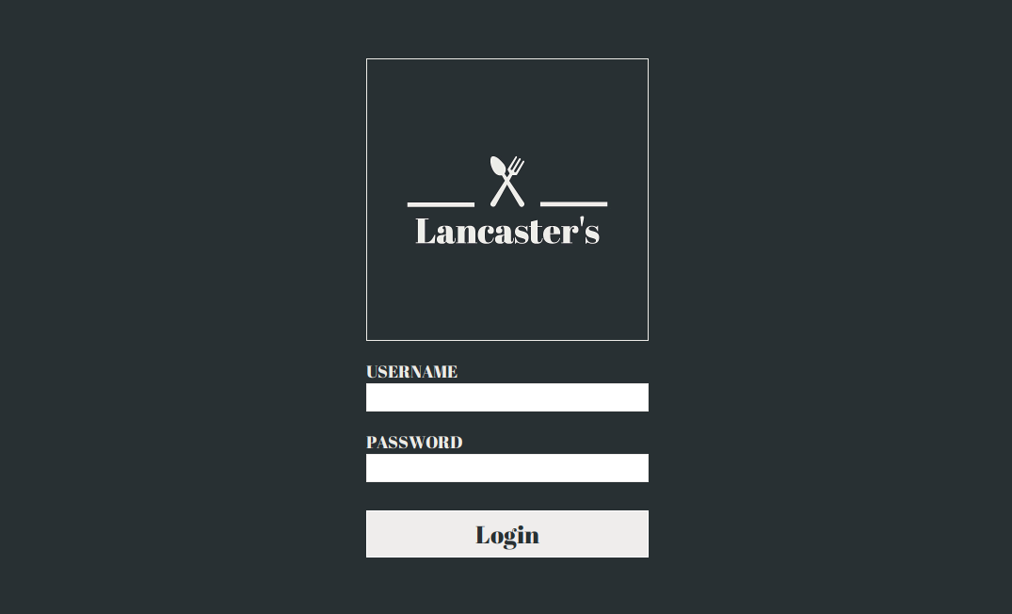
Class: Login
Contains a Clabel called labelUsername and then a CTextField called fieldUsername
logo which is a CLogo
Contains a Clabel called labelPassword and then a CTextField called fieldPassword
buttonLogin which is a Cbutton the functionality of the button within the login class

Slide 3
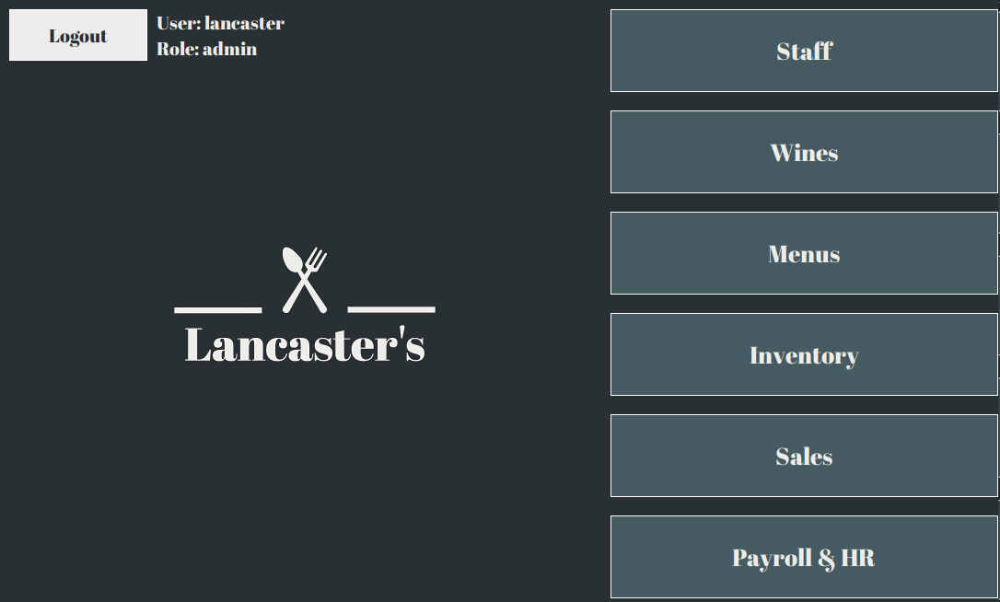
Class: Home
buttonStaff which is a CButton
Contains a Clabel called labelUser and labelRole which also calls the MAuthUser class
buttonLogout which is a Cbutton
buttonWines which is a CButton
buttonMenus which is a CButton
buttonInventory which is a CButton
logo which is a CLogo
buttonSales which is a CButton
buttonPayroll which is a CButton

Slide 4
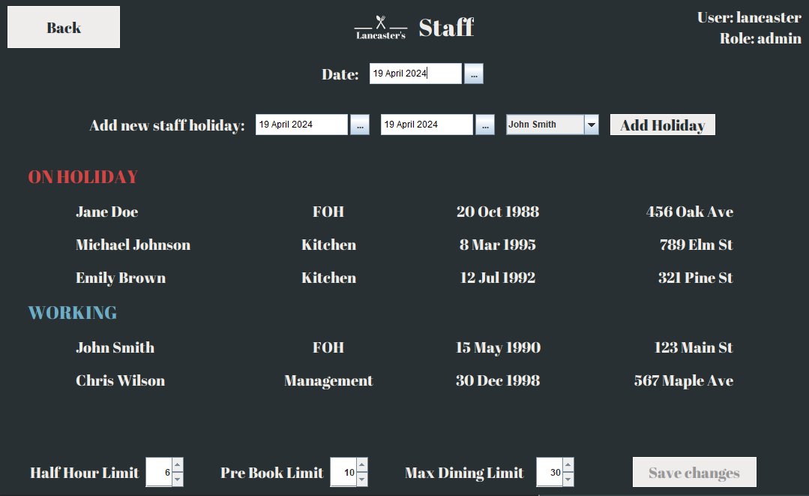
Class: Staff
labelDate which is a CLabel
datePicker which is a CDatePicker
addHoliday which is a CButton
Navbar which is a CNavbar
labelAddHoliday which is a CLabel
labelHoliday which is a CLabel
Contains CDatePicker called holidayFrom and holidayTo
JComboBox of class MStaffMember called comboStaff
labelName is a CLabel
which uses class MStaffMember
and list staffHoliday
labelRole is a CLabel
which uses class MStaffMember
and list staffHoliday
labelDob is a CLabel
which uses class MStaffMember
and list staffHoliday
labelAddress is a CLabel
which uses class MStaffMember
and list staffHoliday
labelNotHoliday which is a CLabel
labelName is a CLabel
which uses class MStaffMember
and list staffAvailable
labelRole is a CLabel
which uses class MStaffMember
and list staffAvailable
labelDob is a CLabel
which uses class MStaffMember
and list staffAvailable
labelAddress is a CLabel
which uses class MStaffMember
and list staffAvailable
spinnerHalfHour which is a JSpinner
spinnerPreBook which is a JSpinner
spinnerMaxDining which is a JSpinner
saveButton which is a CButton
labelHalfHour which is a CLabel
labelPreBook which is a CLabel
labelMaxDining which is a CLabel

Slide 5
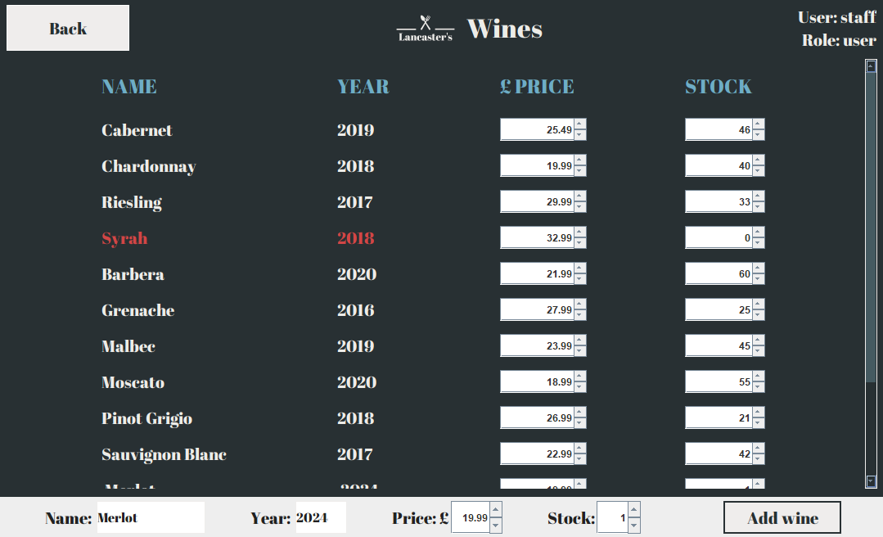
Class: Wines
Navbar which is a CNavbar
headerName which is a CLabel
headerYear which is a CLabel
headerPrice which is a CLabel
headerStock which is a CLabel
spinnerPrice is a CLabel
which uses class MWine
and list wines
spinnerStock is a CLabel
which uses class MWine
and list wines
labelName is a CLabel
which uses class MWine
and list wines
labelYear is a CLabel
which uses class MWine
and list wines
Contains a CLabel called editName and a CTextField called nameText
Contains a CLabel called editYear and a CTextField called yearText
Contains a CLabel called editPrice and a JSpinner called spinnerPrice
Contains a CLabel called editStock and a JSpinner called spinnerStock
Contains a Cbutton called
wineButton

Slide 6
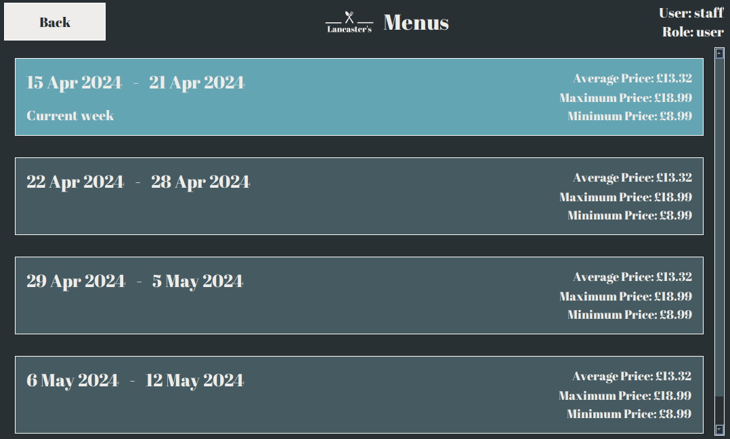
Class: Menus
Navbar which is a CNavbar
labelCurrent which is a CLabel
Uses Clabel called labelDate which contains CDate
Contains 3 CLabel called labelAvgPrice, labelMaxPrice and labelMinPrice which uses class CPrice

Slide 7
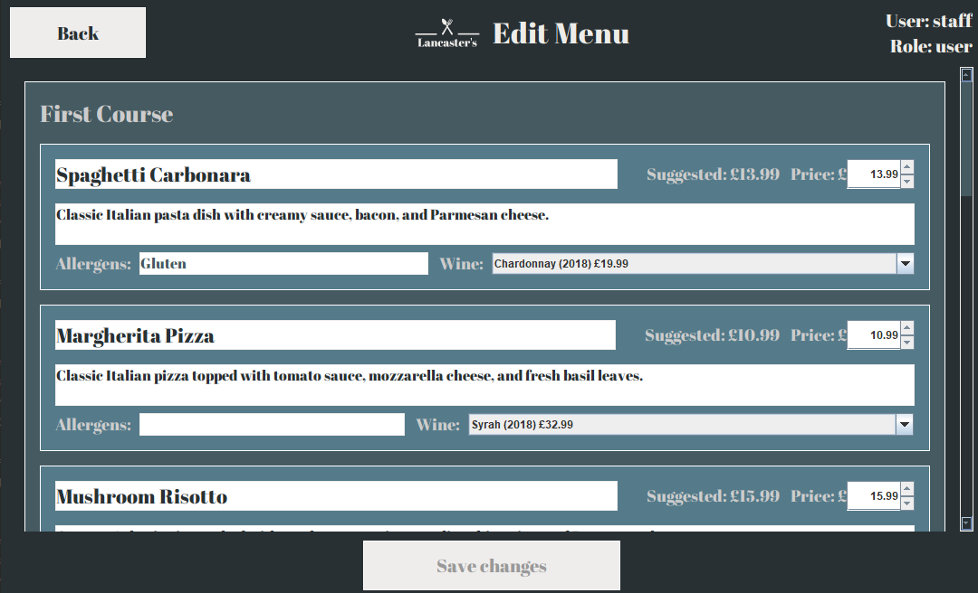
Class: EditMenus
Navbar which is a CNavbar
Uses CTextField called fieldDishName
Uses CLabel called labelDishPrice
Uses JSpinner called spinnerDishPrice
Uses Clabel called labelCourseName
Uses CTextArea called areaDescription
Uses CTextField called fieldDishAllergens
Uses JComboBox of class MWine called comboWine
Uses CLabel called labelDishAllergens
Uses CLabel called labelWine

Slide 8
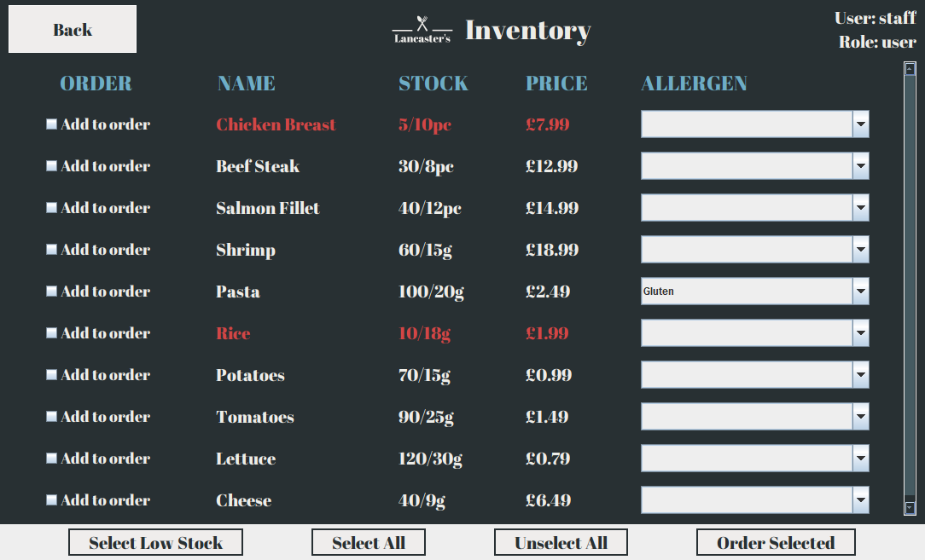
Navbar which is a CNavbar
Uses JComboBox called comboAllergen from class MAllergen
Uses CLabel called headerOrder, headerName, headerStock, headerPrice and headerAllergen.
Uses CLabel called labelStock which uses list ingredient from class MIngredients
Uses CLabel called labelPrice which uses list ingredient from class MIngredients
Uses JCheckBox called boxOrder
Uses CLabel called labelName which uses list ingredient from class MIngredients
Uses CButton called SelectLowButton
Uses CButton called SelectAllButton
Uses CButton
called SelectNoneButton
Uses CButton
called
orderButton

Slide 9
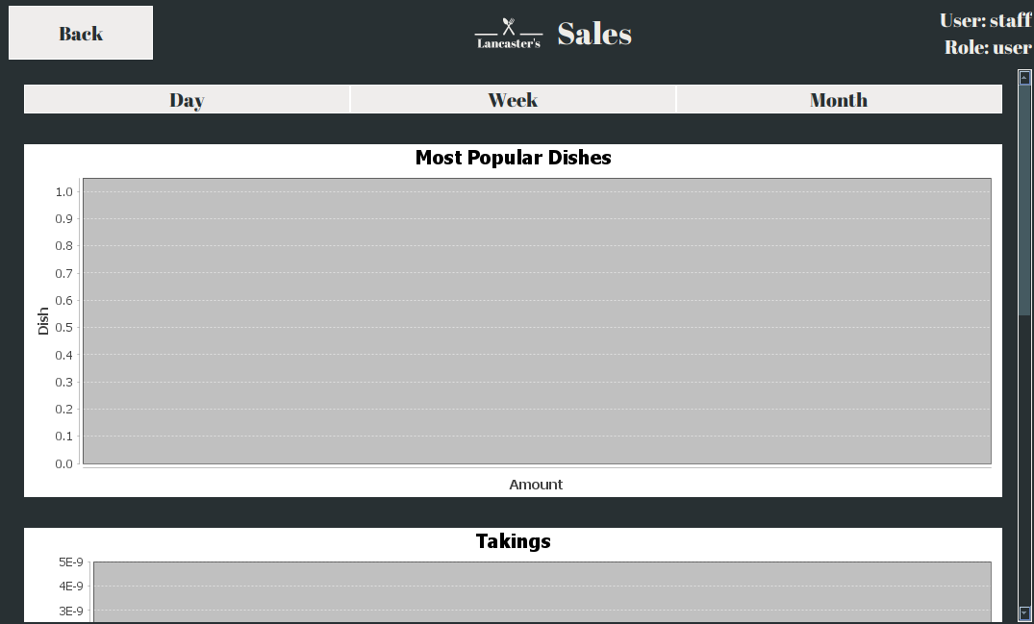
Navbar which is a CNavbar
Has 3 Cbutton called day, week and month
Uses JFreeChart called chart1
Uses JFreeChart called chart1

